Slide 1
读后续写素材

Slide 2
1.动作类
2.情绪类
3.谈话类
4.外貌类
5.性格类
6.环境类

Slide 3
1.动作类
与“跑、跳、行走”等相关的词汇
walk across a street步行穿过马路
walk arm in arm 臂挽着臂走
pace back and forth 来回踱步
jump to one's feet一跃而起
walk gracefully步态优美地走
rush out of the room 冲出房间

Slide 4
1.动作类
与“看、听、说”相关的词汇
remark评论 add补充说
stare at凝视 take a look at看
listen impatiently 不耐烦地听
glare angrily at sb.对某人怒目而视
glance around/round the room 扫视房间
overhear a funny conversation 无意间听到一段好笑的谈话

Slide 5
高分例句
The door burst open and Tom ran into the room.
门突然打开，汤姆跑进了房间。
He put down his glass and rose to his feet.
他放下杯子站了起来。
Harry dashed off before she had a chance to thank him.
她还没来得及说声谢谢，哈里就匆匆离开了。

Slide 6
高分例句
Mrs. Sather looked at my eyes as if(she were)seeing my inner self locked away inside.
Sather老师看着我的眼睛，仿佛看到了我灵魂深处封闭的自我。
The boy wolfed down the food.
这个男孩狼吞虎咽地吃下了食物。
When asked if he wanted anything else, he just shook his head.
当问他是否要点别的时，他只是摇了摇头。

Slide 7

2.情绪类
与“喜悦和满意”相关的词汇
be in high spirits情绪高涨
be pleased beyond description快乐难以言表
light up喜逐颜开
be content/satisfied with 对……满意
be delighted at 对……很高兴
with pleasure非常乐意

Slide 8
2.情绪类
与“喜悦和满意”相关的词汇
a bright/shining smile灿烂的微笑
a mixture of excitement and happiness 既兴奋又开心
burst into laughter/burst out laughing突然大笑起来
be wild with joy/delight欣喜若狂
be joyful about/at/over对……很高兴

Slide 9

2.情绪类
与“悲伤和烦恼”相关的词汇
sob啜泣 be sad at heart心里悲伤
be down in spirits情绪低落 an ocean of sadness悲伤的海洋
burst into tears/burst out crying大哭起来
be clouded with grief阴沉的悲伤
be in low spirits情绪低落 fall into despair陷入绝望
feel depressed/discouraged 感到沮丧/泄气
have a worried look 愁眉苦脸

Slide 10

2.情绪类
与“生气和怨怒”相关的词汇
be very angry at 对……很生气 feel angry/annoyed 感到恼怒/生气
be seized by anger 充满愤怒 be fuming with rage大发雷霆
tremble with anger 愤怒得颤抖
a look of burning anger愤怒的一眼
glare at sb.怒视某人 flare up勃然大怒
be in a rage一怒之下 be mad at 对……生气

Slide 11
高分例句
The smile on her face shone like a diamond.
她脸上的笑容像钻石一样闪闪发光。
A smile of understanding flashed across his face.
他脸上露出了一种理解的微笑。
A ripple of excitement ran through them.
他们心中涌起一阵兴奋的涟漪。
Laughter lingered around the room.
笑声在房间里萦绕。

Slide 12
高分例句
I was pleased beyond description.
我高兴得难以形容。
She wore a shining smile on her face.
她脸上带着灿烂的笑容。
Her smile lit up the whole room.
她的笑容照亮了整个房间。
She shed tears of joy.
她高兴得流下了眼泪。

Slide 13
高分例句
His eyes twinkled with pleasure.
他的眼睛闪烁着快乐。
Unforgettable were her eyes that shone like diamonds and lips held in a steady smile.
令人难忘的是她的眼睛像钻石一样闪闪发光，嘴角保持着稳定的微笑。
I was wild with joy.
我欣喜若狂。
Her eyes were sparkling like diamonds.
她的眼睛闪着钻石般的光芒。

Slide 14
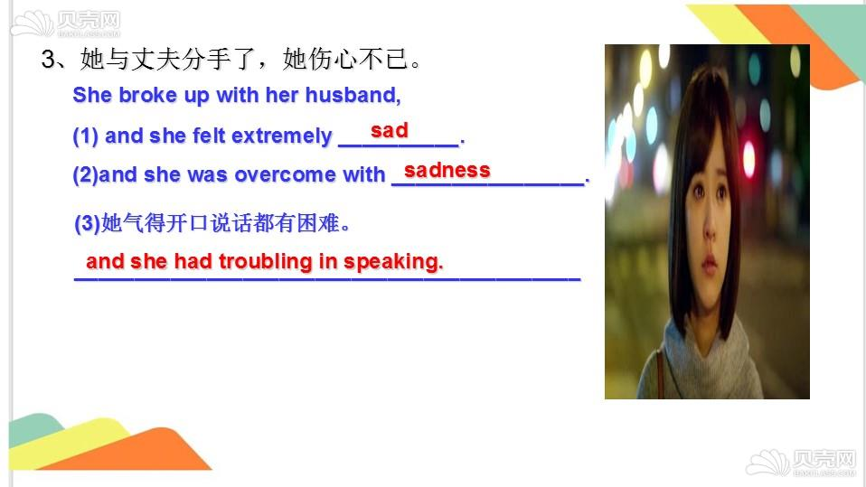
高分例句
He stood silently, tears rolling down his cheeks.
他静静地站着，眼泪顺着面颊流了下来。
I feel like I am floating in an ocean of sadness.
我感觉自己漂浮在悲伤的海洋里。
Her hands were shaking.She was on the verge of tears.
她的手在颤抖。她快要哭了。
Hearing the news, so desperate was he that he drowned sadness in wine.
听到这个消息，他是如此绝望，以至于借酒消愁。

Slide 15
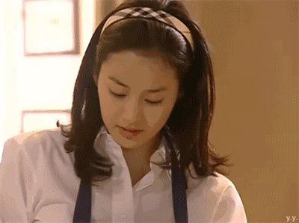
高分例句
She was overflowing with happiness.
她洋溢着幸福。
Her flushed face was shining with excitement.
她激动得满脸通红。
Joy welled up inside her.
她心中涌起喜悦。
Amusement gleamed in his eyes.
他的眼睛流露出愉快的神情。

Slide 16
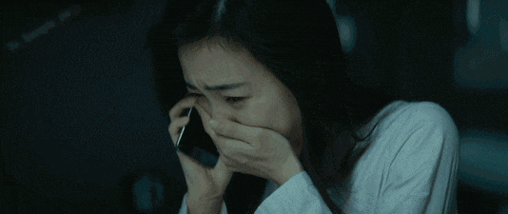
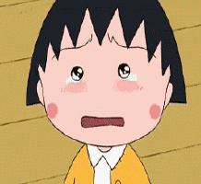
高分例句
She burst into tears and ran out of the room.
她突然哭了起来，跑出了房间。
She sobbed, hiding her face in her hands.
她掩面哭泣。
I tried to fight back tears./My eyes were filled with tears.
我努力忍住眼泪。/我的眼里充满了泪水。
A frown now stood on his face.
他皱起了眉头。

Slide 17
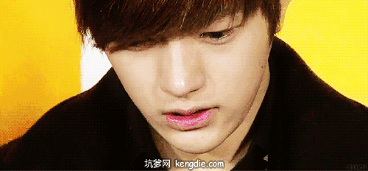
高分例句
They sat there with glum looks on their faces.
他们坐在那里，带着一脸忧郁。
The news cast a cloud of gloom over his face.
这消息使他脸上蒙上了一层阴影。
They were immersed in sorrow.
他们沉浸在悲痛之中。
These days he was in low spirits.
这些日子他情绪低落。

Slide 18
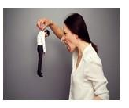
高分例句
I was seized by anger.
我充满了愤怒。
He was fuming with rage.
他气得大发雷霆。
His anger boiled over.
他的愤怒爆发了。
He could hardly/scarcely contain his rage.
他几乎控制不住怒火。

Slide 19

高分例句
He was breathing fire and fury.
他充满着怒火。
His voice trembled with anger.
他的声音因愤怒而颤抖。
He gave me a look of burning anger.
他愤怒地看了我一眼。
He glared at me with burning eyes.
他用灼热的目光怒视着我。

Slide 20
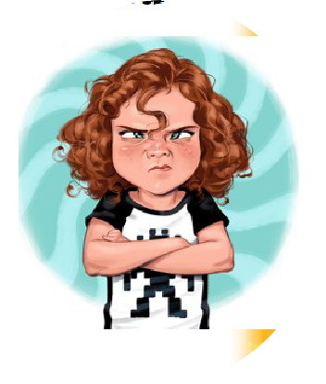
高分例句
He flared up at the word.
他一听到这个字就勃然大怒。
His face clouded with anger.
他气得脸色阴沉。

Slide 21
3.谈话类
answer sb./make an answer to sb.回答某人
tell sb.sth./tell sth.to sb.告诉某人某事
remind sb.that...提醒某人…… explain sth.clearly 清晰解释某事
talk about sth.谈论某事 mention sth.提及某事
announce/declare that...宣布……
make an announcement/a declaration that...宣布……
whisper to sb.gently对某人温柔耳语
yell out/cry out to sb.大声朝某人喊叫
complain about.../have a complaint to sb.抱怨……

Slide 22
3.谈话类
comments on 评论…… object to/raise an objection 反对……
disagree with/have a disagreement with sb.不同意
claim that...声称…… give a description of 描述……
argue with sb.over sth./have an argument with sb.over sth.与某人争论某事，reply directly/immediately/quickly to 直接/立即/迅速答复……
respond to/make a response to响应
react to/have a reaction to对……作出反应
promise sth./make promises about对……作出许诺

Slide 23
4.外貌类
与“外貌”相关的词汇
skinny瘦骨嶙峋的 cool酷的
lively活泼的 lovely可爱的
strong 强壮的
a girl with bright big eyes有大而明亮的眼睛的女孩
a boy with glasses戴眼镜的男孩
be in one's mid-40s四十几岁
be somewhere between 25 and 30 years old 25-30岁之间
be of medium height/of average height/about 5 feet tall中等身高

Slide 24
4.外貌类
与“外貌”相关的词汇
handsome英俊的 good-looking好看的
athletic健壮的 muscular壮实的
pretty漂亮的 beautiful美丽的
attractive迷人的 plain相貌平平的
slim苗条的 thin瘦的
fat胖的 overweight肥胖的

Slide 25
4.外貌类
与“外貌”相关的词汇
have short hair/medium length hair/long hair/long wavy dark hair/long and straight hair/short and curly hair短发/中等长度的头发/长发/长卷黑发/长直发/短卷发
have got a baby face/round face/an intelligent face娃娃脸/圆脸/聪明的脸
high/broad/rounded/flat/narrow forehead 前额高/宽/圆/平/窄
big/bright/dark/attractive eyes 眼睛大/亮/黑/迷人
hooked nose and a square chin鹰钩鼻和方下巴

Slide 26
5.性格类
与“性格”等相关的词汇
confident自信的 modest谦虚的
brave勇敢的 cheerful开朗的
kind善良的 friendly友好的
generous大方的 honest诚实的
independent独立的 reliable可靠的
patient耐心的 outgoing外向的
sensitive敏感的，decisive果断的

Slide 27
5.性格类
与“性格”等相关的词汇
ambitious雄心勃勃的 punctual守时的
sociable善于交际的 easygoing随和的
gentle温和的 considerate善解人意的
thoughtful体贴的 understanding理解的
optimistic乐观的 frank坦率的
straightforward直截了当的 helpful乐于助人的
humorous幽默的 careful仔细的
energetic 精力充沛的 warm-hearted热心肠的，

Slide 28
5.性格类
big-headed令人头疼的 bad tempered 脾气很坏的
boring乏味的 bossy专横的
dull迟钝的 dishonest不诚实的
envious嫉妒的 fussy挑剔的
impatient不耐烦的 jealous嫉妒的
lazy懒惰的 rude粗鲁的

Slide 29
5.性格类
mean吝啬的 selfish自私的
shy害羞的 timid胆怯的
stubborn固执的 careless粗心的
clumsy笨拙的 greedy贪婪的
conceited自负的 pessimistic悲观的
aggressive有攻击性的 cruel残酷的

Slide 30
6.环境类
the blue sky 蓝天 the songs of birds鸟鸣
the thundering clouds电闪雷鸣 the fragile flowers娇嫩的花
the green grass 青草 the fragrant roses 芬芳的玫瑰
the setting/ rising sun落日/冉冉升起的太阳
a gust of wind一阵风 the soft and cold wind轻柔却寒冷的风
the drooping branches of the weeping willow弯柳的低垂枝条

Slide 31
高分例句
A bright light streamed through the window, flooding the opening and spreading in a wide circle on the ceiling.
一道明亮的光线流过窗户，淹没了窗口，并在天花板上呈现一个光圈。
The breeze gently kissed her cheeks.
微风轻柔地亲吻着她的脸颊。
The feathery snowflakes danced in the night air, making a beautiful picture.
鹅毛般的雪花在夜空中飞舞，像一幅美丽的图画。

Slide 32
高分例句
As the night advanced, the clouds closing in and densely overspreading the whole sky, then very dark, it came on to blow harder and harder.
当深夜来临时，云急剧地合拢起来，整个天空乌云密布，昏暗无比。
The scenery along the journey is just like a breath-taking landscape painting.
沿路的风景就像一幅美丽的山水画卷。
The icy wind started howling, cutting my face like a sharp knife.
寒风开始咆哮，像锋利的小刀一样刺痛了我的脸。

Slide 33
高分例句
Almost as clearly as the sun could, the moon's still pale light picked out vast sweeping stretching of distance, the grass shimmering and rippling like a restless sight, silver and white and grey.
几乎就像在阳光下那样，一切都看得一清二楚。静穆、清淡的月光照出了广阔无垠、一览无余的远方。微光扑朔的草地发出了一片低低的窸窣声，像是不肯停歇的低回浩叹。草原上闪动着一派银色、白色、灰色。

Slide 34




Homework
Read and write
The twins wanted to prepare a surprise for their mother in the morning, only to make the kitchen a mess. Luckily, their father appeared and made some food as they wished. Then he sneaked back to bed.
Para 2.The twins carried the breakfast upstairs and woke their mother up .____
Mother ：____________
Her face： _________
Her body：_________
Father?

Slide 35

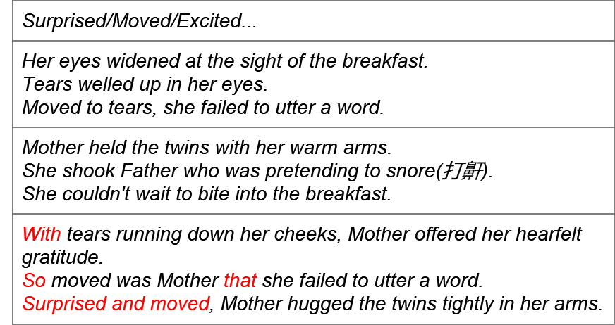
My sample：

Slide 36
谢
谢
lao
师

